Slide 1

Medical Store-Distributor-Consumer Network
Proposal and Feasibility Presentation Template
Abdulla Iqbal FA17-BSE-030
Armaghan Hassan FA17-BSE-045
Majid Durani FA17-BSE-021
Supervisor: Sir Kashif Nasir
Department of Computer Science
COMSATS University Islamabad, Abbottabad Campus

Slide 2
Agenda of the Presentation
The agenda is to find out the feasibility report of the project (Medical Store-Distributor-Consumer-Network).
Motivation
Introduction
Scope
Functionalities
Proposed Tools/Platform
Feasibility
Schedule
Tasks for 1st Iteration (or 30%)

Slide 3
Motivation
To develop an interactive Website and App
It will allow both companies and retailers to manage their stock
To overcome the medicine shortage problem.
It will make it easier for them to keep track of their inventory and will maintain the data of their buying and selling.
All this method is all on paper we are digitalizing this all.

Slide 4
Brief Introduction
The Medical Store Distributor Consumer Network (MSDCN) is a medicine stock inventory system which will be used in Medical store and Pharmaceutical companies. This website will store details of medicine purchase and selling. The system will maintain purchases and selling detail w.r.t retailer and company. The system will consist of automatic billing and reporting module. Furthermore the website will also help the shopkeeper to automatically place the order if the stock is short from the shop and will be able to track his shipment.

Slide 5
Scope
Our system will target Medicine market.
The problem with current medicine market is that all the communication, transactions, order placing, and order delivery is based on paperwork and wire transfers which results in delays and no monitoring.
Our system will provide online platform for both Medical Stores and Pharmaceutical Companies.
It will allow them to monitor transaction, order details, order delivery status, point of sale details, inventory managements.
Physical Order Delivery will not be covered by this system.

Slide 6
Functionalities
User can register company or retailer shop
User can add guest employee
User will be able to mange their sales
User can mange their stock
System can automatically place order
User can view the reports generated by the system
User can pay online and can see all previous transactions detail

Slide 7
Proposed Tools/Platform
Visual Studio Code
Android Studio
Star UML
MS Visio
Laravel Php Framework
Html, Css, Java Script

Slide 8


Feasibility
Technical feasibility
All the hardware is available like laptops and cell phones, and technically it is possible to make this project.
The API’s that will be used are:
Email Verification
Contact verification
Payment method

Slide 9
Feasibility
Financial feasibility
The tools which we will be using are free and there is no hardware, so no cost.
The only cost present is of
Buying Hosting $15
Android Store Buy-in $10

Slide 10
Feasibility
Resource feasibility
Human resources Such as Team members and useable equipment (Laptops and Cell phones) are available for the project.

Slide 11
Feasibility
Operational feasibility
Website and App developed will be officially released and no ethical problems will occur during development, human recourses will be available after the system has been installed.

Slide 12
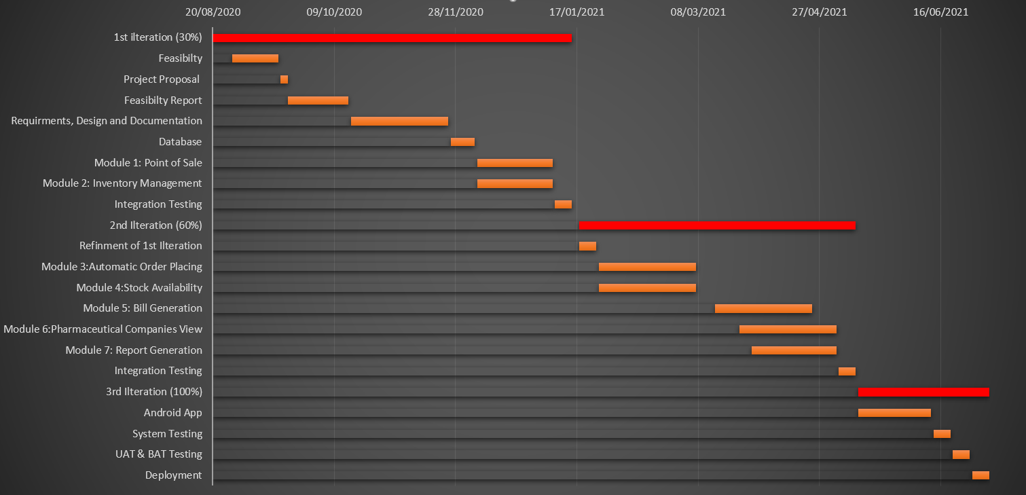
Schedule
Schedule (GANTT Chart)

Slide 13
Tasks for 1st Iteration (or 30%)
Software Requirements Specifications (SRS)
Software Design Specification (SDS)
Database
Back end logic of adding items in inventory
Back end logic of adding items to cart.

Slide 14
Conclusion

